Slide 1

Music Recommendation Project
CS 582 Semester Project By: Van, Alex, Brenden, Alejandro, and Nahla

Slide 2
Purpose
Users now have access to millions of songs thanks to the explosion of music streaming services, but they frequently have trouble finding the music they enjoy.
Our goal is to create a music recommendation system that may offer users songs or playlists based on their listening habits, tastes, and other considerations in order to solve this issue. However, in order for such a system to be successful and functional, there are a number of obstacles that must be solved.
Personalization: Different users have different preferences and tastes in music, and the system needs to be able to account for these differences to provide truly personalized recommendations. This requires sophisticated machine learning algorithms that can learn from users' listening histories and adjust recommendations accordingly.

Slide 3
Objective
Our goal is to create a highly effective content-based music recommendation system that can overcome data quality, volume, and personalisation problems. We hope to present customers with tailored and accurate music suggestions that enhance their listening experience and keep them engaged with our platform by creating innovative algorithms that can constantly learn and fit the users needs.

Slide 4
Procedure
And
Challenges
Using the Spotify API:
We first found that the audio features that the API gives are not very in-depth
In addition: we found that developers cannot “build products or services that mimic, or replicate or attempt to replace a core user experience of Spotify” which we found was a bit too close to our use case.
Finding Alternate Datasets:
After switching off Spotify, we looked for alternative datasets that would still allow us to provide the same functionality as before, just without the API.
Plan A :
Our original plan was to make a music recommendation algorithm based on a whole user’s playlist using the Spotify API, where we would categorize different songs based on audio characteristics.

Slide 5

Procedure
And
Challenges
Plan B :
Our back-up plan was to use a different dataset, instead of the Spotify API.
The dataset used is “Million-Song_Dataset”, which was created 2011 as a collaborative project between The Echo Nest and LabROSA.
The core of the dataset is the feature analysis and metadata for one million songs. The dataset does not include any audio, only the derived features.

Slide 6
Concept
Dataset extracted features included:
MFCC (12 columns)
Mel-Frequency Cepstral Coefficient
“The inverse Fourier transform of the log of the short-term power spectrum of the original signal”
Used to model human hearing response, which is non-linear.
It can be used to model recognizing emotions of a speaker’s voice, and to recognize the speaker, which is useful for a music recommendation system.
Chroma (12 columns)
Features related to pitch and timbre, and allow for a high degree of accuracy to small changes.
Aggregate for a given local time window all information that relates to a given chroma into a single coefficient.
Captures harmonic and melodic characteristics of music, while being robust to changes in timbre and instrumentation.

Slide 7
Results
We successfully developed a music recommendation algorithm that recommends similar songs given a song that a user liked. Throughout the project, we encountered various challenges such as using the large datasets and finding the best method to group similar songs. Despite these obstacles, we were able to overcome them through effective teamwork and problem-solving.

Slide 8
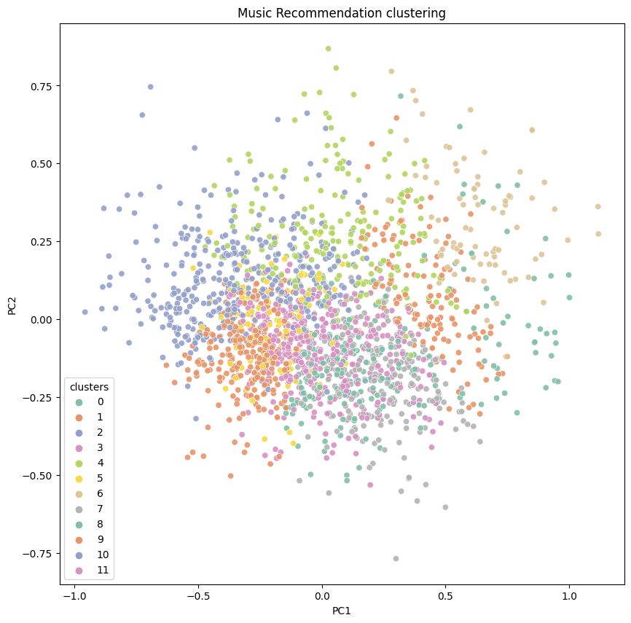
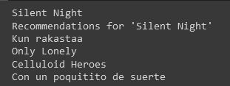
Results
Our recommendation algorithm uses K-means as a method of clustering the songs based on audio characteristics.
Recommendations are taken from the nearest neighbors of the input song that are in the same cluster

Slide 9

Conclusion
We gained valuable experience in machine learning, and data analysis, which allowed us to create a functioning algorithm that delivers accurate and engaging recommendations to users.
By the project delivery time we expect to use a larger subset of the Million Song dataset and to further explore alternative methods of modeling the recommendation algorithm.

Slide 10

Thank You
Questions/Concerns

